Slide 1
Money and Monetary Policy
Topic 4/ Chapter 29 & 30

Slide 2
Money
Money is any token or other object that functions as a medium of exchange that is socially and legally accepted in payment for goods and services and in settlement of debts.
Economists, however, use the word in a more specific sense: Money is the set of assets in an economy that people regularly use to buy goods and services from other people.

Slide 3
Money
Money includes:
Currency: particularly the many circulating currencies with legal tender status, and
Various forms of financial deposit accounts: such as demand deposits, savings accounts, and certificates of deposit. In modern economies, currency is the smallest component of the money supply.

Slide 4
Functions of Money
Three functions of Money:
  MEDIUM OF EXCHANGE,
  A UNIT OF ACCOUNT, AND
  A STORE OF VALUE

Slide 5
Functions of Money
Medium of exchange: Money is used as an intermediary for trade, in order to avoid the inefficiencies of a barter system. Such usage is termed a medium of exchange.
Medium of exchange is an item that buyers give to sellers when they want to purchase goods and services.
Unit of account: A unit of account is a standard numerical unit of measurement of the market value of goods, services, and other transactions. A unit of account is a necessary prerequisite for the formulation of commercial agreements that involve debt.
Store of value, an item that people can use to transfer purchasing power from present to the future.

Slide 6
Liquidity
Economists use the term Liquidity to describe the case with which an asset can be converted into the economy’s medium of exchange. Because money is the economy’s medium of exchange, it is the most liquid asset available.
Assets vary widely in their liquidity. Most stock and bond can be easily sold with small cost , so they relatively liquid assets.

Slide 7
Types of money (Commodity money)
Commodity money has an intrinsic value.
It is any money that is both used as a general purpose medium of exchange and as a tradable commodity in its own right. An example is coins made of precious metal.
Commodity-based currencies are often viewed as more stable, but this is not always the case. The value of a commodity-based currency as a medium of exchange depends on its supply relative to other goods and services available in the economy.
Historically, gold, silver and other metals commonly used in commodity-based monetary systems have been subject to regular and sometimes extraordinary fluctuations in purchasing power.
Commodity money's ability to function as a store of value is also limited by its nature. For example, copper and tin risk rust and corrosion, and gold and silver are soft metals that can lose weight through scratches and abrasions.

Slide 8
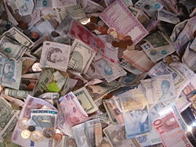
Types of money (Fiat money)

Slide 9
Fiat money
Fiat money is any money whose value is determined by legal means, rather than the strict availability of goods and services which are named on the representative note.
Fiat money is created when a type of credit money (typically notes from a central bank, such as the Bangladesh Bank) is declared by a government act (fiat) to be acceptable and officially-recognized payment for all debts, both public and private.

Slide 10
Money supply
The money supply is the amount of money within a specific economy available for purchasing goods or services.
The supply in the US is usually considered as four escalating categories M0, M1, M2 and M3.
The categories grow in size with M3 representing all forms of money (including credit) and M0 being just base money (coins, bills, and central bank deposits). M0 is also money that can satisfy private banks' reserve requirements.
In the US, the Federal Reserve is responsible for controlling the money supply, while in the Euro area the respective institution is the European Central Bank. Other central banks with significant impact on global finances are the Bank of Japan, People's Bank of China and the Bank of England.

Slide 11
The measures of money
Symbol | Assets included
C/M₀ | Currency
M1 | Currency plus demand deposits, traveler’s check, other checkable deposits
M2 | M1 plus saving deposits, small time deposits
M3 | M2 plus large time deposits, Eurodollars,

Slide 12
Monetary policy
Monetary policy is the process by which a government, central bank, or monetary authority manages the money supply to achieve specific goals.
Usually the goal of monetary policy is to accommodate economic growth in an environment of stable prices.
A failed monetary policy can have significant detrimental effects on an economy and the society that depends on it. These include hyperinflation, stagflation, recession, high unemployment, shortages of imported goods, inability to export goods, and even total monetary collapse and the adoption of a much less efficient barter economy. This happened in Russia, for instance, after the fall of the Soviet Union.

Slide 13
Tools to control money supply
Open market operations (selling or buying bonds)
Raising or lowering bank reserve requirements
Bank rates

Slide 14
Tools of Monetary Policy
1- Discount rate: the interest rate that the central bank charges on the commercial banks.
2- Required reserve ratio: the percentage of deposits that is required by the commercial bank to keep as reserves in the central bank
3- Open market operation: the purchase and sale of government securities (bonds) by the central bank

Slide 15
Discount rate and Supply of money by banks
Discount rate: the interest rate that the central bank charges on the commercial banks.
Government control the commercial bank to accumulate government fund for loan
Lower discount rate is easy money policy, commercial bank can supply loan at a lower interest rate

Slide 16
Required reserve ratio and Supply of money by bank
Required reserve ratio (RRR): percentage of deposits that is required by the commercial bank to keep as reserves in the central bank.
Example: if RRR =10% , of an initial deposit = Tk 100
Required reserve = Tk 100 * 10% = Tk 10
Excess reserves = Tk 100 -10 = Tk 90
Total Reserve = Required reserve + Excess reserve

Slide 17
An expansionary monetary policy tools:
Reducing discount rate : reduce interest rate stimulate consumption & investment expenditure increase AE
Reducing RRR : increase money supply lower interest rate stimulate consumption & investment expenditure increase AE
Buying government securities : increase money supply lower interest rate stimulate consumption & investment expenditure increase AE

Slide 18
A contractionary monetary policy tools:
Increasing the discount rate : increase interest rate lower consumption & investment expenditure lower AE
Raising RRR : reduce money supply raise interest rate reduce consumption & investment expenditure reduce AE
Selling government securities : lower money supply raise interest rate reduce consumption & investment expenditure reduce AE

Slide 19
Money Supply, Money Demand, and Monetary Equilibrium
Money demand has several determinants, including interest rates and the average level of prices in the economy.
People hold money because it is the medium of exchange.
  The amount of money people choose to hold depends on the prices of goods and services.
In the long run, the overall level of prices adjusts to the level at which the demand for money equals the supply.

Slide 20
Money, Prices, and Inflation
So, the quantity theory of money states that the central bank, which controls the money supply, has ultimate control over the rate of inflation.
If the central bank keeps the money supply stable, the price level will be stable. If the central bank increases the money supply rapidly, the price level will rise rapidly.

Slide 21
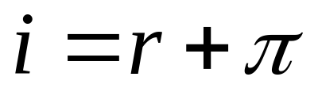
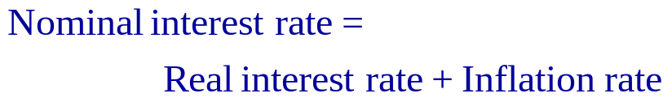
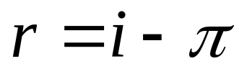
Inflation and the Interest Rate

Slide 22
An expansionary monetary policy:
Can be applied in case of unemployment and recession
i
Ms
Ms₂
i
i₂
Md
Qm
q
q₂
If the central bank increases the money supply lower
interest rate stimulate consumption and investment
expenditure , i.e increases AE (other things are kept same)

Slide 23
A contractionary monetary policy :
Can be applied in case of an inflation
Ms₂
i
Ms
i₂
i
Md
q₂
Qm
q
If the central bank reduces the money supply raise
interest rate reduced consumption and investment
expenditure , i.e reduce AE (other things are kept same)

